Slide 1

Python Anti-spam
14.3.2022

Slide 2

Agenda
Introduction
How do we classify ‘spam’
When would people use this
Short break
Planning for technical debt
Building data agnostic systems
The boring bits, documentation & automated tests

Slide 3

INTRODUCTION
A lifecycle overview
Who am I
What is this package
What niche does this fill
Notes:
Programming for ~3 years
Studying towards a masters in comp sci
First big commitment / package
Yarn about
Idea between 2 friends in late 2020
Javascript had antispam packages, but not py
Built for discord
Spam is a big issue, especially antispam tailored to your needs

Slide 4
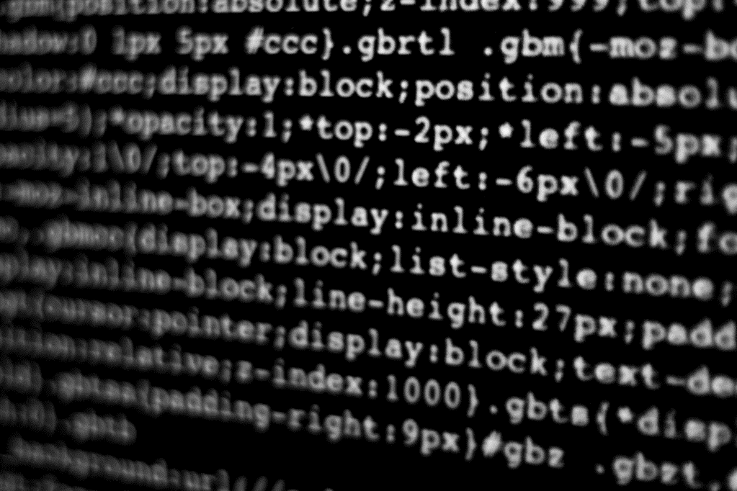
How do we classify spam?
Distinguishing spam from conversations
Notes:
Spam in our context takes the form of text based messages, not phishing etc
This form of spam usually refers to messages, which are unwanted / unsolicited
These messages normally come from a malicious actor
levenshtein distance
This is the minimum number of single character edits
We use a token based sort
This involves tokenizing the string, sorting alphabetically and then comparing ratios
Token based sort was picked as it yielded the ‘best’ results

Slide 5
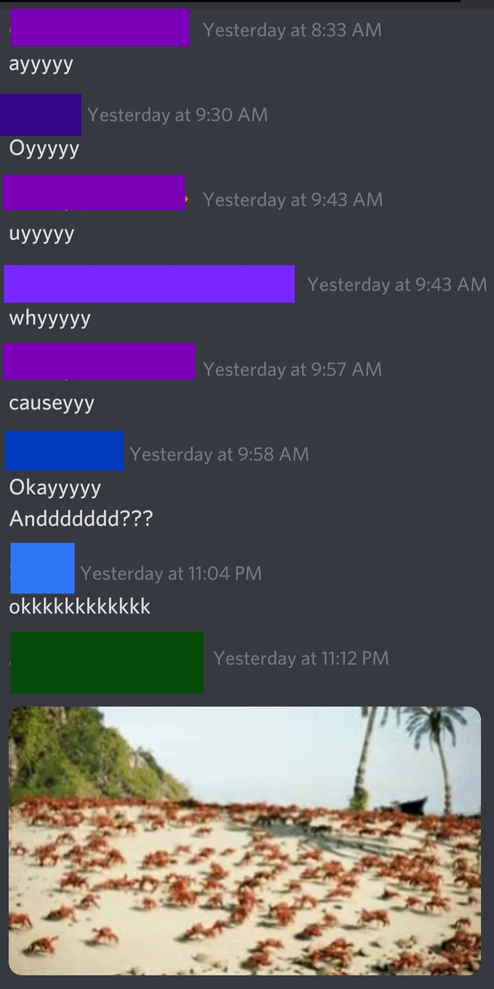
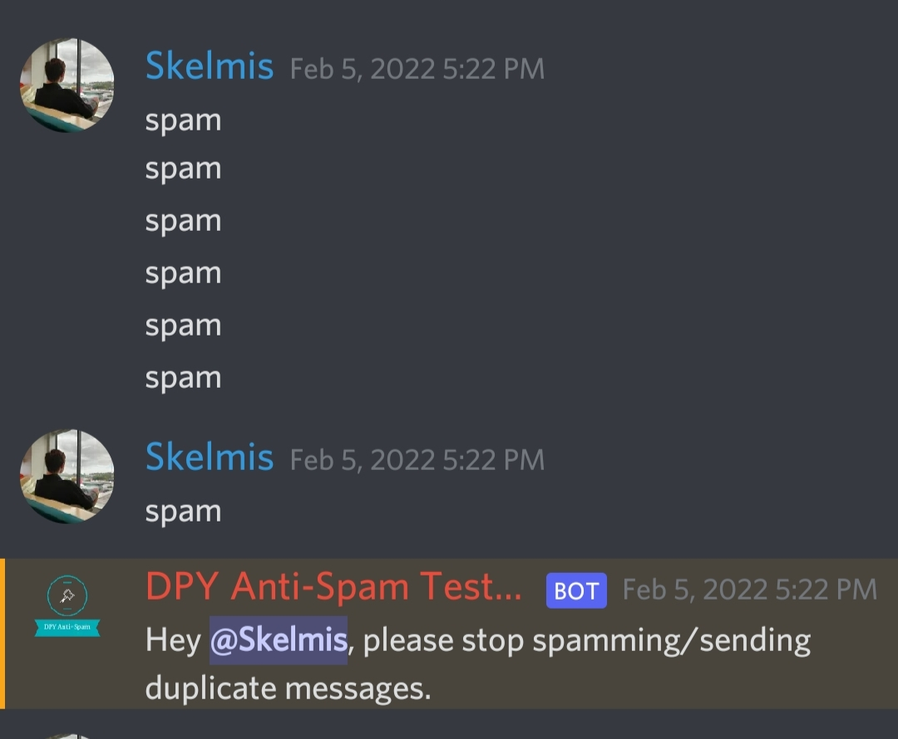
Notes:
Each colour is someone different
We classify spam currently as ‘per person’
How do we handle images, media, etc?
At-least on discord, we can guarantee images have a url. So we can use this
The right image shows exact matches, however, we can catch configurable options
We also have a ‘time period’ in which messages can be valid
Will show usages on next slide

Slide 6
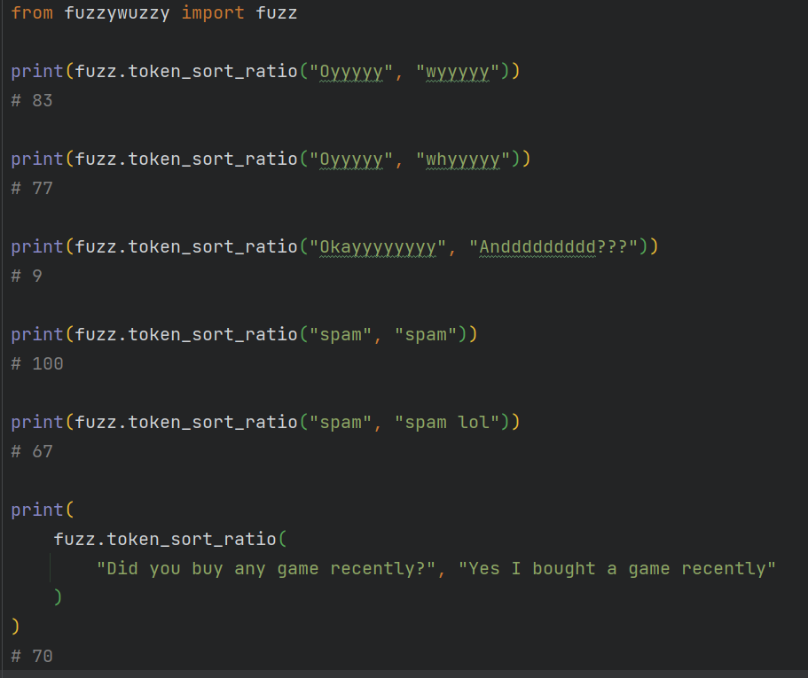
levenshtein distance of strings
Notes:
This is out of 100, where 100 is the exact same
Optional extras to provide 4-10x speedups with lower level implementations

Slide 7

When would people use this
Automated Antispam
Automated mass mention protection
Plugins for pretty much anything
Notes:
Explain that 1 mention is essentially 1 notification, so people spamming them gets shit fast

Slide 8
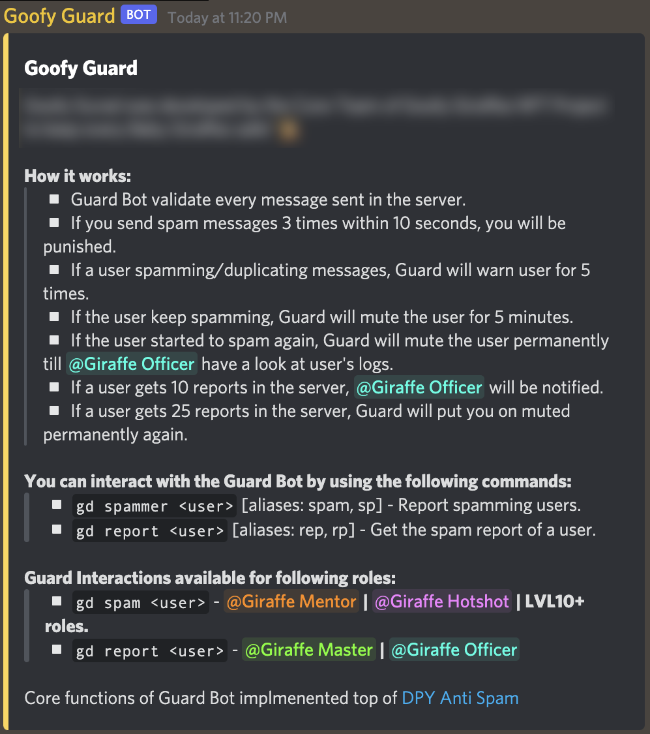
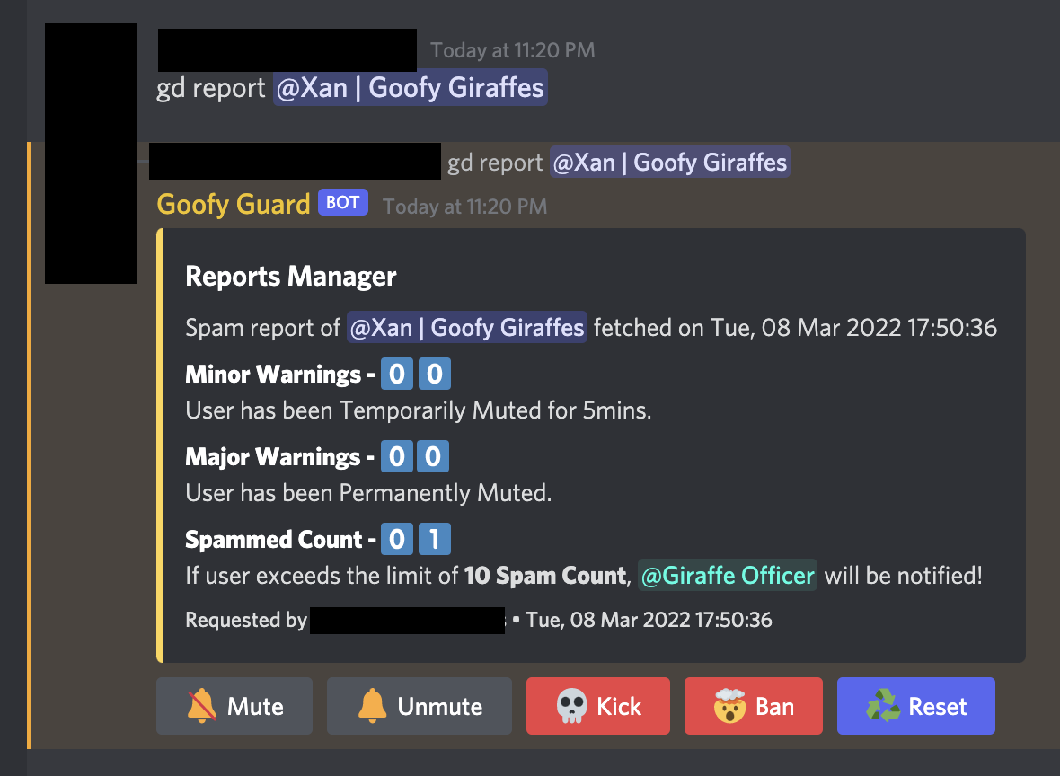
Example end usage
This package serves as the core functionality
Further functionality implemented with plugins
Notes:
Plugins used to customise things like punishments
Good documentation and support allows for things like hooking into the cache from outside of the handler itself, such as the right image.

Slide 9
Short break

Slide 10

Planning for technical debt
It happens to everyone
Notes:
Introduce what technical debt actually is
Essentially it boils down to features at the expense of code quality
Who actually wants to go rewrite ‘working’ code to make it better for us to deal with? Your not adding new features, therefore motivation, the ability to convince your manager, etc, are hard to come by

Slide 11
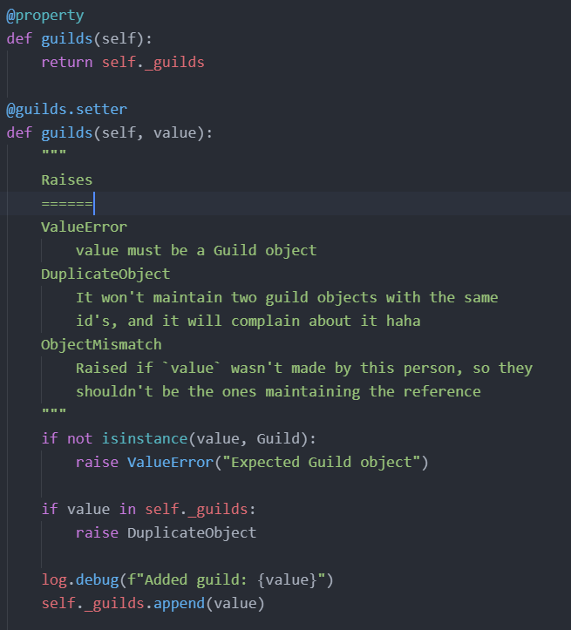
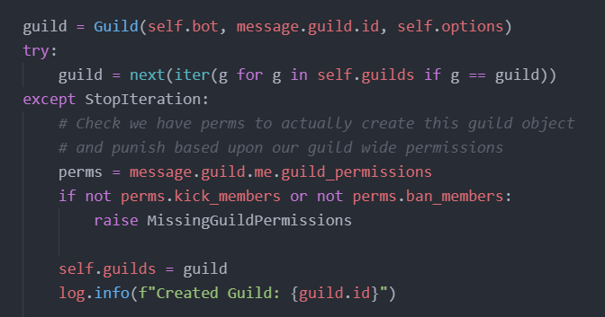
Here’s some alpha code, notice any issues?
Notes:
We stored guilds, objects which we had the ability to get in O(1), in a list
We could easily (and do now), store these in a dictionary
This is a prime example of technical debt, where simply getting a feature to work was ‘good enough’ and lead to me ignoring some fundamental issues
For those wondering what `self.guilds = …` did, let me show you..
It’s a setter, which looks really bad and is hard to understand

Slide 12
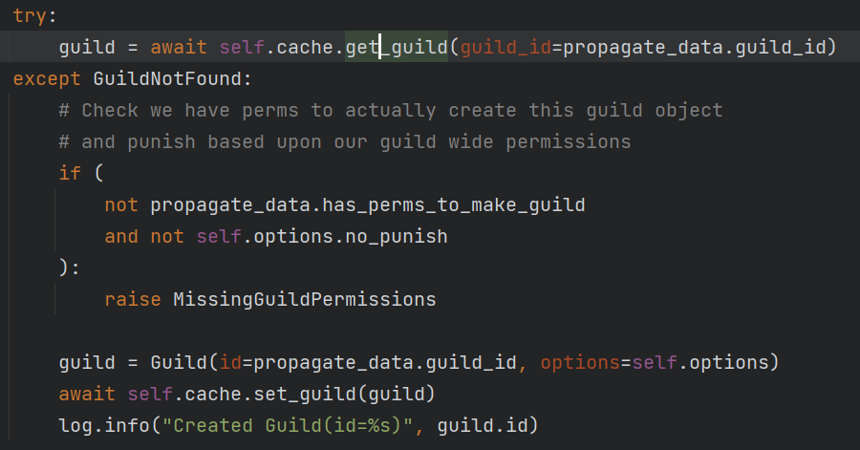
This is the latest implementation
Notes:
Note that `self.cache` is an abstraction which allows the end user to implement their own cache
Reference this is the next topic
This lookup should be O(1), assuming the end cache is developed properly

Slide 13

Tips
If you don’t fully understand your end goal, don’t just start coding and hope
Design, design, and more design
Set standards, and follow them
Understand its inevitable and set aside time for refactoring
Notes:
I like to know what my ‘end goal’ that I am working towards is
This lets me make designs inline with the final product
Map out how you want your code / product to look like once complete
Its 10x easier to redesign something if you don’t need to re-implement everything
Standards
Things like code standards, pep8, documentation standards, etc
Personally pep8, through the automated tool black have helped keep my code clean and makes it sooo much easier to read
Technical debt is inevitable
Set aside time to work on issues, or at-least understand your pain points
Don’t beat yourself up, stuff happens

Slide 14
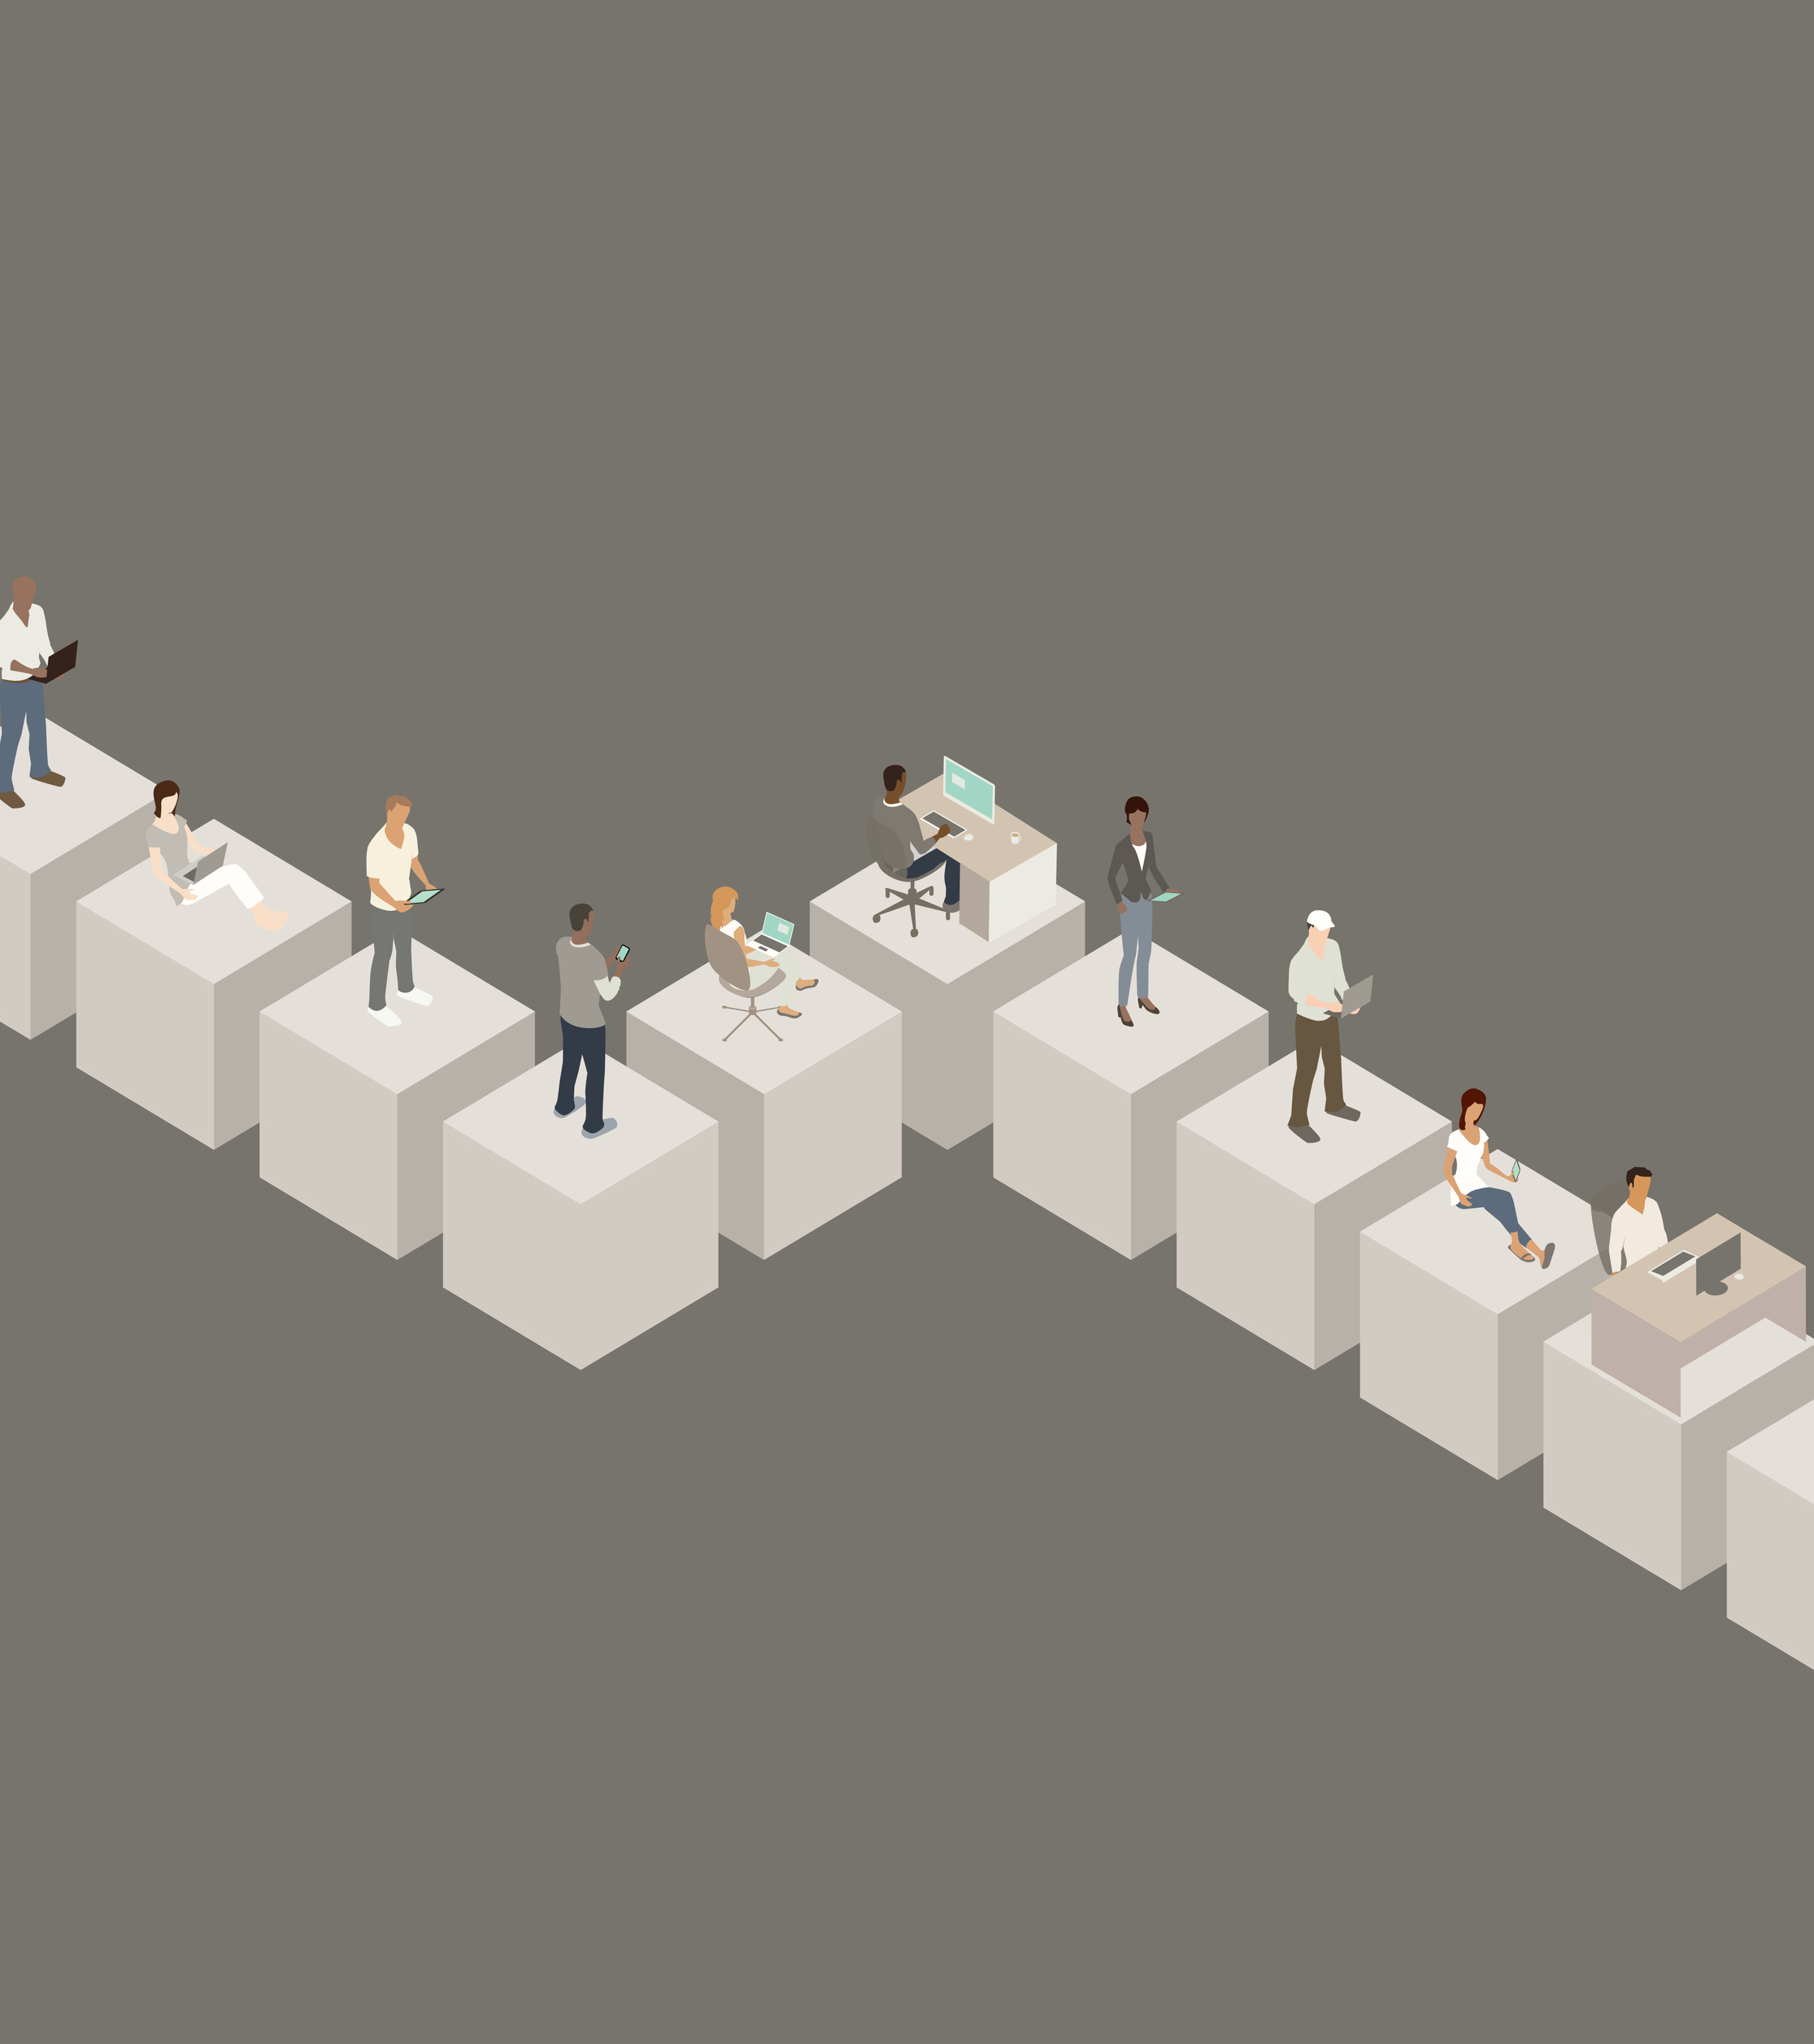
Building data agnostic systems
Because your way, isn’t everyone's way
Notes:
Data agnostic essentially means it works with any data
Not everyone wants to use the system in the way you do
So the idea being:
A) You can use any cache you want, i.e redis if you wish
B) You can use this package with any python discord wrapper I personally feel you could stretch it to work with literally anything assuming the following are met
‘messages’ have a unique id and content
‘users’ have unique ids

Slide 15
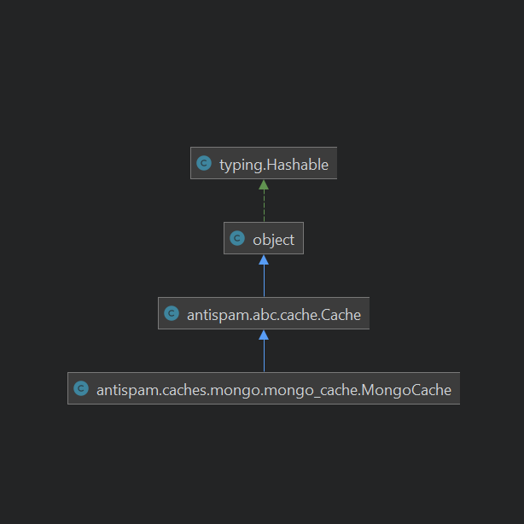
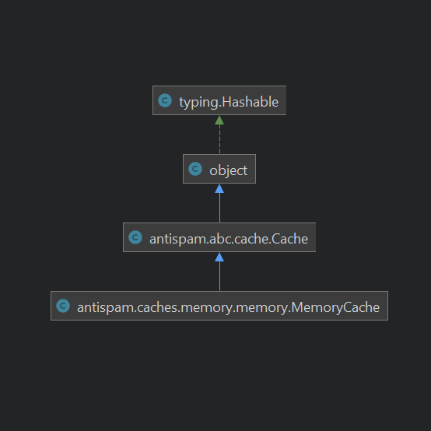
Python protocols
Introduced in 3.8
Provides an easy way to allow the user to implement things how they want
Runtime checkable
Notes:
Essentially an interface
The end user implements the methods and we can check if they have
Essentially saying hey, if you implement ‘Cache’, you can plug and play your class into the system and it should just work
This implementation is runtime checkable, at-least for existence of the methods defined on the protocol
Isinstance checks before we setup the handler to use provided items
We use two such protocols
Cache For the cache backed system, so the user can easily implement things like a redis cache if they wished
Data ingest By turning the data ingest from discord into a Protocol, it acts as an abstraction layer which means our (package) code is not dependant on 1 system, and instead should just work with any form of data ingest assuming it meets the requirements of the protocol

Slide 16


The boring things
Documentation
Automated tests
Straightforward usage
Notes:
Documentation should:
Exist and cover most cases, have you ever used software where it is easier to read source code? I have, and it wasn’t enjoyable
Ideas should be conveyed in an easy to understand format which still provides all the information a user could want
Testing is a requirement
If you don’t test your code, your leaving the door wide open for both bugs now as well as future regressions. I personally aim to use tests for regressions, while manually testing new features as it lets me get ‘hands on’ more then code based tests
Further, these tests should be run using some form of continuous integration. What's the point of tests if they aren’t used?
Discuss test coverage
Software should make sense. If your software is convoluted to use, don’t expect it to last long. I personally think this ties quite heavily back into that initial design stage

Slide 17


THANK YOU
Ethan McKee-Harris
ethan@koldfusion.xyz
https://koldfusion.xyz

